Slide 1
The Battle of Neighborhoods

Slide 2
Introduction
My presentation is for those who are planning to start a new restaurant. I'll try to provide as many suggestions on what all factors need to be considered while starting a new venture.
Here I will be focusing on problems one might face while opening a new restaurant in a city. There are various factors which should be considered while opening a small or big level business

Slide 3
Business Problem
Well there are many factors to be considered to open a small or big level business. Some of those are
Location for her new restaurant
Rent of location
Other restaurants in that area
Population

Slide 4
Data Description
I have taken our data from following sources
https://web.archive.org/web/20180822060556/https://www.rentcafe.com/average-rent-market-trends/us/ca/sanfrancisco/ , and https://www.zillow.com/research/data/)
I have managed to clean the data so that I can use it properly

Slide 5
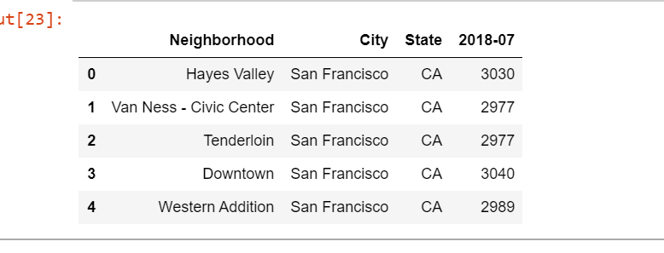

Slide 6
I’m have used a formula to find which neighborhood is good to open a new restaurant. Before coming up with a formula, I was wondering what all factors can we consider because it's really unfair to compare data of 10 years old restaurant with 1 year old restaurant
So I concluded to use the rating of restaurant

Slide 7
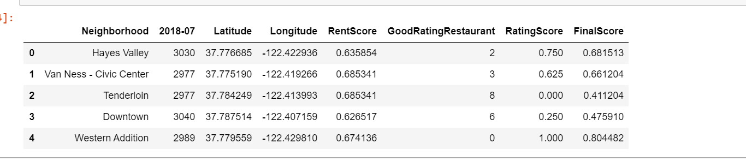

Slide 8
Methodology
To calculate the formula first we have calculated the rent Score. From rent score formula we need maximum and minimum rent of neighbourhood. Maximum and minimum values can be retrieved using max and min built in functions.
maxrentofN = max(dataframename['rentcolumn'])
minrentofN = min(dataframename['rentcolumn’])
Next in order to calculate ratingScore, I have to retrieve rating of each Korean restaurant neighbourhood-wise.

Slide 9
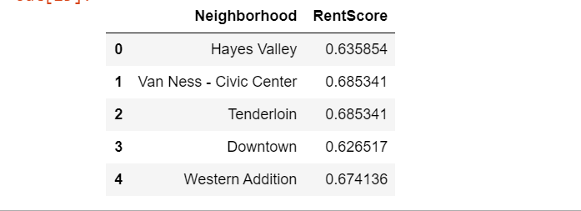

Slide 10
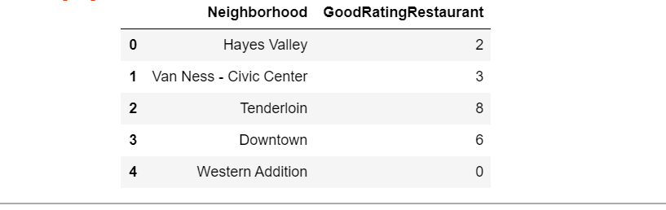

Slide 11
FinalScore = (rentScore)0.6+(ratingScore)0.4 Closer the finalScore value to 1, better choice of neighborhood for the client to decide. I have given more weightage to rent than rating.
Let's see what is rentScore and ratingScore means RentScore can be calculated by
(MAXrent_of_neighborhood -CURRENTrent_of_neighborhood)/(MAXrent_of_neighborhood-MINrent_of_neighborhood).

Slide 12
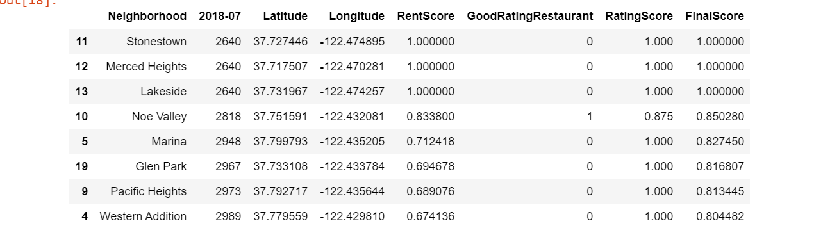
Result and conclusion

Slide 13
Result of my formula which I used to analyze best neighbourhood's for new Korean restaurant is shown in previous slide. If you see carefully I have listed Neighbourhood's which has Finalscore greater or equal to 0.8, so that person has more options to choose from. There are 3 Neighbourhood's in the results which are best suited for person as there is no competition, since there is no good rating restaurants and rent is also comparitively low according to our formula

